Slide 1
Introduction to Reinforcement Learning

Slide 2
The Evolution of RL
The roots of Reinforcement Learning, acronymed as RL, go back to a psychologist, Edward L. Thorndike who talked about learning by trial and error. He studied cats in puzzle boxes. The cat was motivated to come out of the box. The cat would fall around and eventually stumble upon the latch that would open the box. Once the cat managed to get out, the same cat would be put in the same box again. After successive runs, he observed that cats were getting faster in finding and pulling the latch. And on the basis of this behavioural experiment, Thorndike put forward the 'Law of Effect':
“Responses that produce a satisfying effect in a particular situation become more likely to occur again in that situation, and responses that produce a discomforting effect become less likely to occur again in that situation.”

Slide 3
What is Reinforcement Learning?
Reinforcement learning is learning to take an action in a situation in order to maximize numerical reward signal. The agent (the learner) is not told which actions to take, but instead must discover which actions yield the most reward by trying them. Reinforcement learning is similar to 'human learning'.

Slide 4
Origin and history of Reinforcement Learning research
History

Slide 5
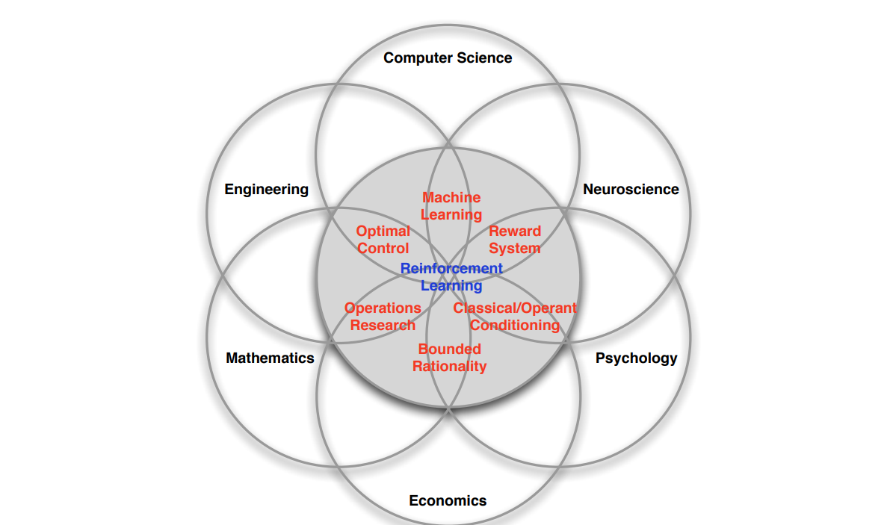
Many faces of Reinforcement Learning

Slide 6
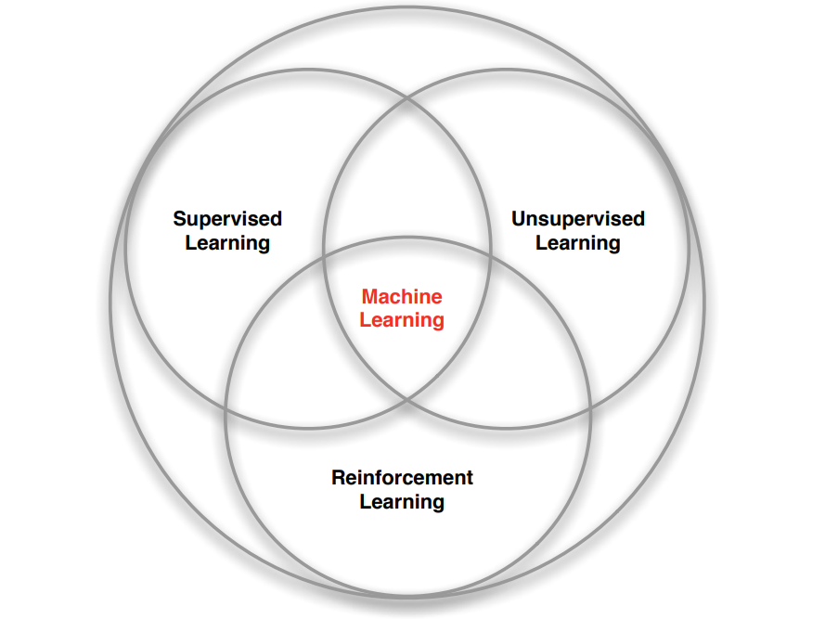
Branches of Machine Learning

Slide 7
Characteristics of Reinforcement Learning
What makes reinforcement learning different from other machine learning paradigms?
There is no supervisor, only a reward signal
Feedback is delayed, not instantaneous
Time really matters (sequential, non i.i.d data)
Agent’s actions affect the subsequent data it receives

Slide 8
RL vs Supervised Learning
The next major difference between the two learning methods is how the performance of the two is measured.
In supervised learning, there is a teacher (ground-truth) which tells you whether the result for a given observation is correct or not. And, then the model can be improved by minimising the error term.
On the other hand, in reinforcement learning, there is no teacher. The environment acts only as a critic, where it tells you how good or bad the action is by giving rewards. It doesn’t tell whether the action taken is the ultimate best or not.

